Slide 1
University Events
Reviewing the value provided by student fees for student-focused events that build tradition and deepen connections to CU Denver.

Slide 2
MISSION & PURPOSE
University Events produces Chancellor engagements, some student, faculty, and staff recognition events, campus-wide events, and all major university ceremonies.
Our mission is to offer a variety of impactful and engaging events that foster campus community, school spirit, and co-curricular learning. We uphold the mission of the university by creating opportunities for participation and providing channels for self-expression, critical thinking, and relationship building.
In addition to producing our own events, we support the efforts of university students, staff, and faculty in successfully managing meetings, conferences, and other school or college events at CU Denver.

Slide 3
STUDENT-FOCUSED EVENTS
In University Events, we help create environments where students can interact with faculty, staff, and the broader community, to connect in a more casual environment with one another and create lasting memories of their time at CU Denver.
New Student Convocation
CU Denver Block Party
Fall and Spring Commencement

Slide 4
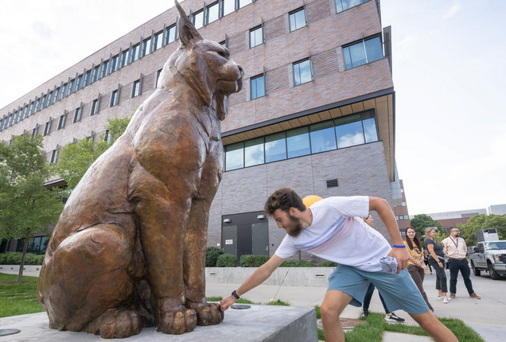
NEW STUDENT CONVOCATION
This event is the official welcome for all new students to the University of Colorado Denver. Just as graduation commemorates the end of a student’s experience, this event marks the beginning of their time at CU Denver.
They receive a class t-shirt and swag items at check-in
Walk by Lynx statue to rub its right paw for good luck
Welcome program in Wellness Center gym; alumni speaker
Convocation Games, community-building activity
Complimentary lunch and involvement fair

Slide 5
ALUMNI CONNECTIONS
Convocation is designed to support a student at the beginning of their transition to CU Denver, whether they are a recent high school graduate or an early transfer student from another institution.
Hearing from alumni as an incoming student can help set the stage for how a student could spend the next four to six years building their personal and professional experiences that will set them up for success after graduation.

Slide 6
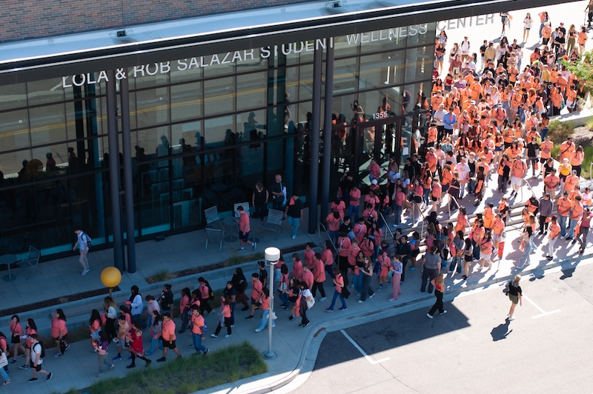
HOW IS IT FUNDED?
Convocation Funding
Total Expenses for New Student Convocation = Roughly $50,000
$23,100 is funded by Student Fees
The other half is funded by the Chancellor’s Office

Slide 7
CU DENVER BLOCK PARTY
This annual back-to-school event is highly anticipated, bringing more than 3,500 participants out to Lawrence Street for anyone who lives, works or studies downtown.
The Block Party showcases the endless opportunities that CU Denver has to offer with booths from schools and colleges to alumni relations, plus representation from other CU Denver and Auraria Campus departments.
Various Denver-area food trucks are present, and CU Denver alumnus Mario “DJ Chonz” Rodriguez is our annual featured entertainment for the event.

Slide 8
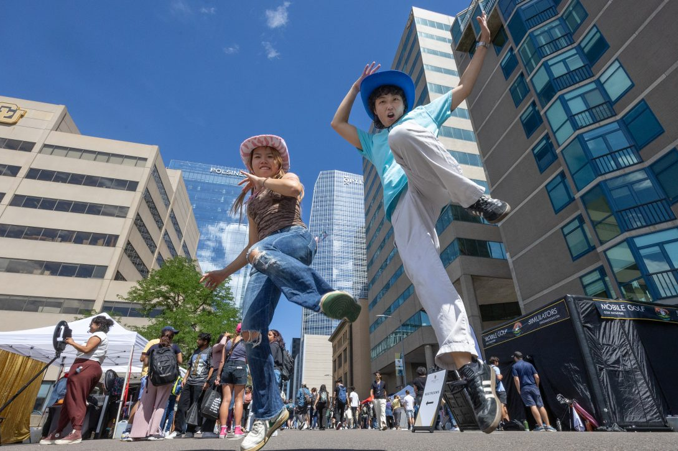
HOW IS IT FUNDED?
Block Party Funding
Total Expenses for New Student Convocation = Roughly $30,000
$0 is funded by Student Fees
Sponsorships from outside organizations like Fitzsimons Credit Union, TIAA, Kalaco Apartments, and Tepin Tasks helped offset expenses by about $5,000
The remainder was covered by the Chancellor’s Office

Slide 9
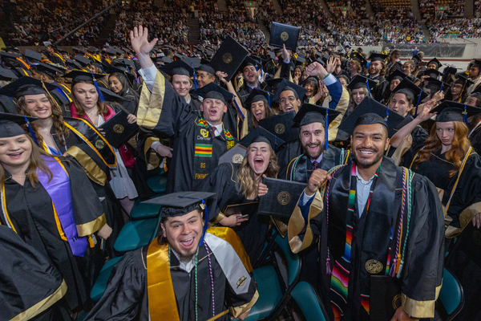
FALL AND SPRING COMMENCEMENT
This event is the official culmination of a student’s academic career at CU Denver. Hosted twice per year, students have an opportunity to celebrate their achievement with family, friends, faculty, staff, and university leadership.
Fall Ceremony - Colorado Convention Center
Single ceremony will all schools and colleges
Spring Ceremonies – Denver Coliseum
Two ceremonies (A.M. & P.M.)

Slide 10
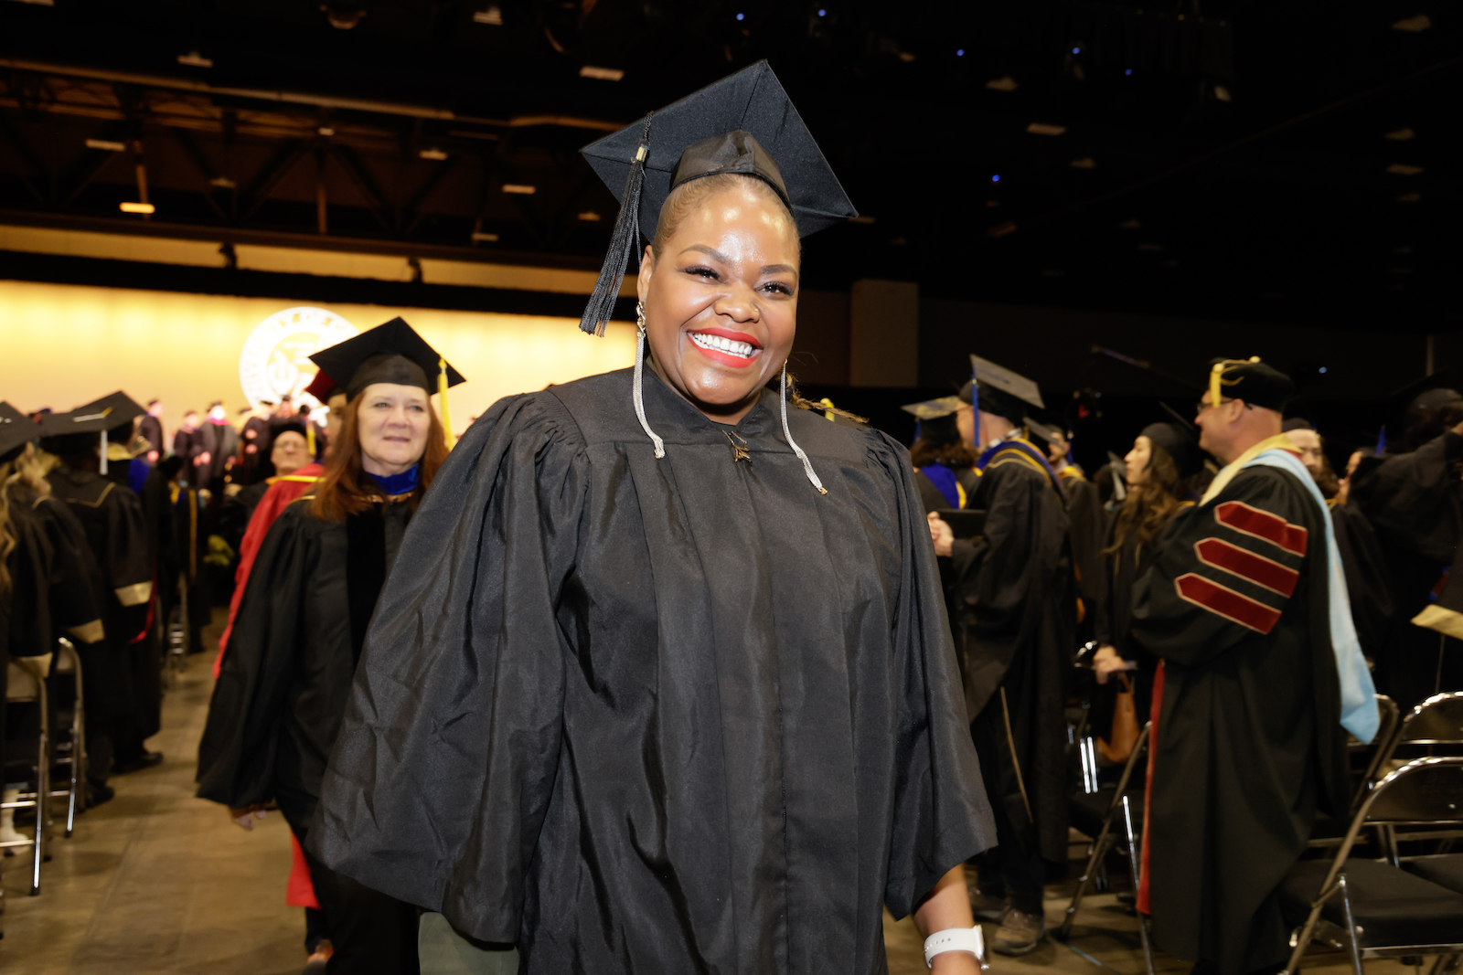
HOW IS IT FUNDED?
Commencement Funding
Total Expenses for both commencement ceremonies = Roughly $300,000
Full amount is funded by Student Fees

Slide 11
CONTACT INFORMATION
JOHN ROGERS
Executive Director, Engagement & Events
University Communications
1380 Lawrence Street, Suite 1300
john.t.rogers@ucdenver.edu
ucdenver.edu/events

