Slide 1

Budget Allocation Review Committee (BARC)
September 23-October 7, 2024
Ann M. Sherman, Executive Vice Chancellor
Finance & Administration
Jen St. Peter, AVC Budget & Financial Planning

Slide 2
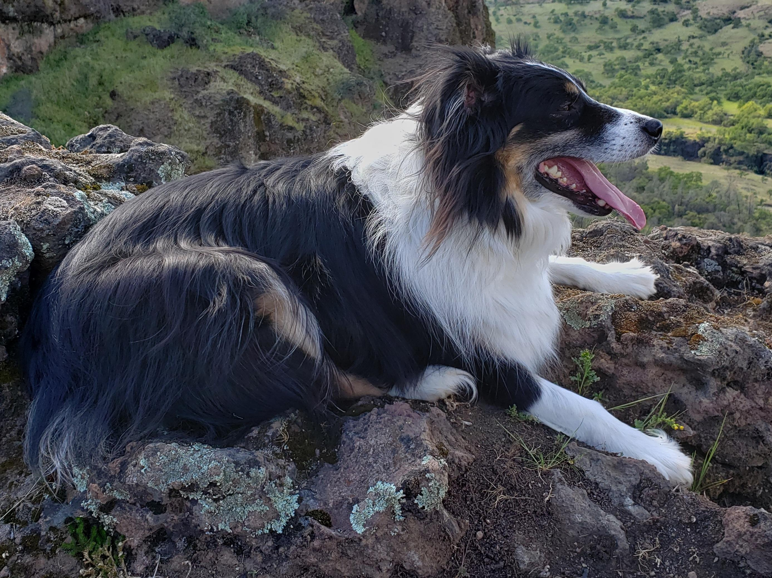
Outline of Presentation
Purpose of BARC
Representation on BARC
Initial topics covered
Key Messages from the committee’s 2 sessions
Work Plan over next several months

Slide 3
Purpose of BARC and Expected Outcomes
The key objective/outcome of this team’s work is a recommendation regarding CU Denver’s future budget allocation process which will:
Build a healthy financial awareness that aligns with CU Denver’s strategy and enables adaptive responses to emerging opportunities.
Establish a multi-year financial horizon which includes an understanding of revenue, as well as enduring allocation principles which facilitate our institutional objectives.
Explore budgeting principles in ways that enable each institutional unit to be successful in contributing to our collective mission and purpose.
Identify improvements to the allocation process that increase institutional strategic flexibility, transparency, and accountability in decision-making.
Support the future work of shared governance groups across the CU Denver campus through the development of timely, accurate information by which to encourage informed discussion and debate on matters of common interest.

Slide 4
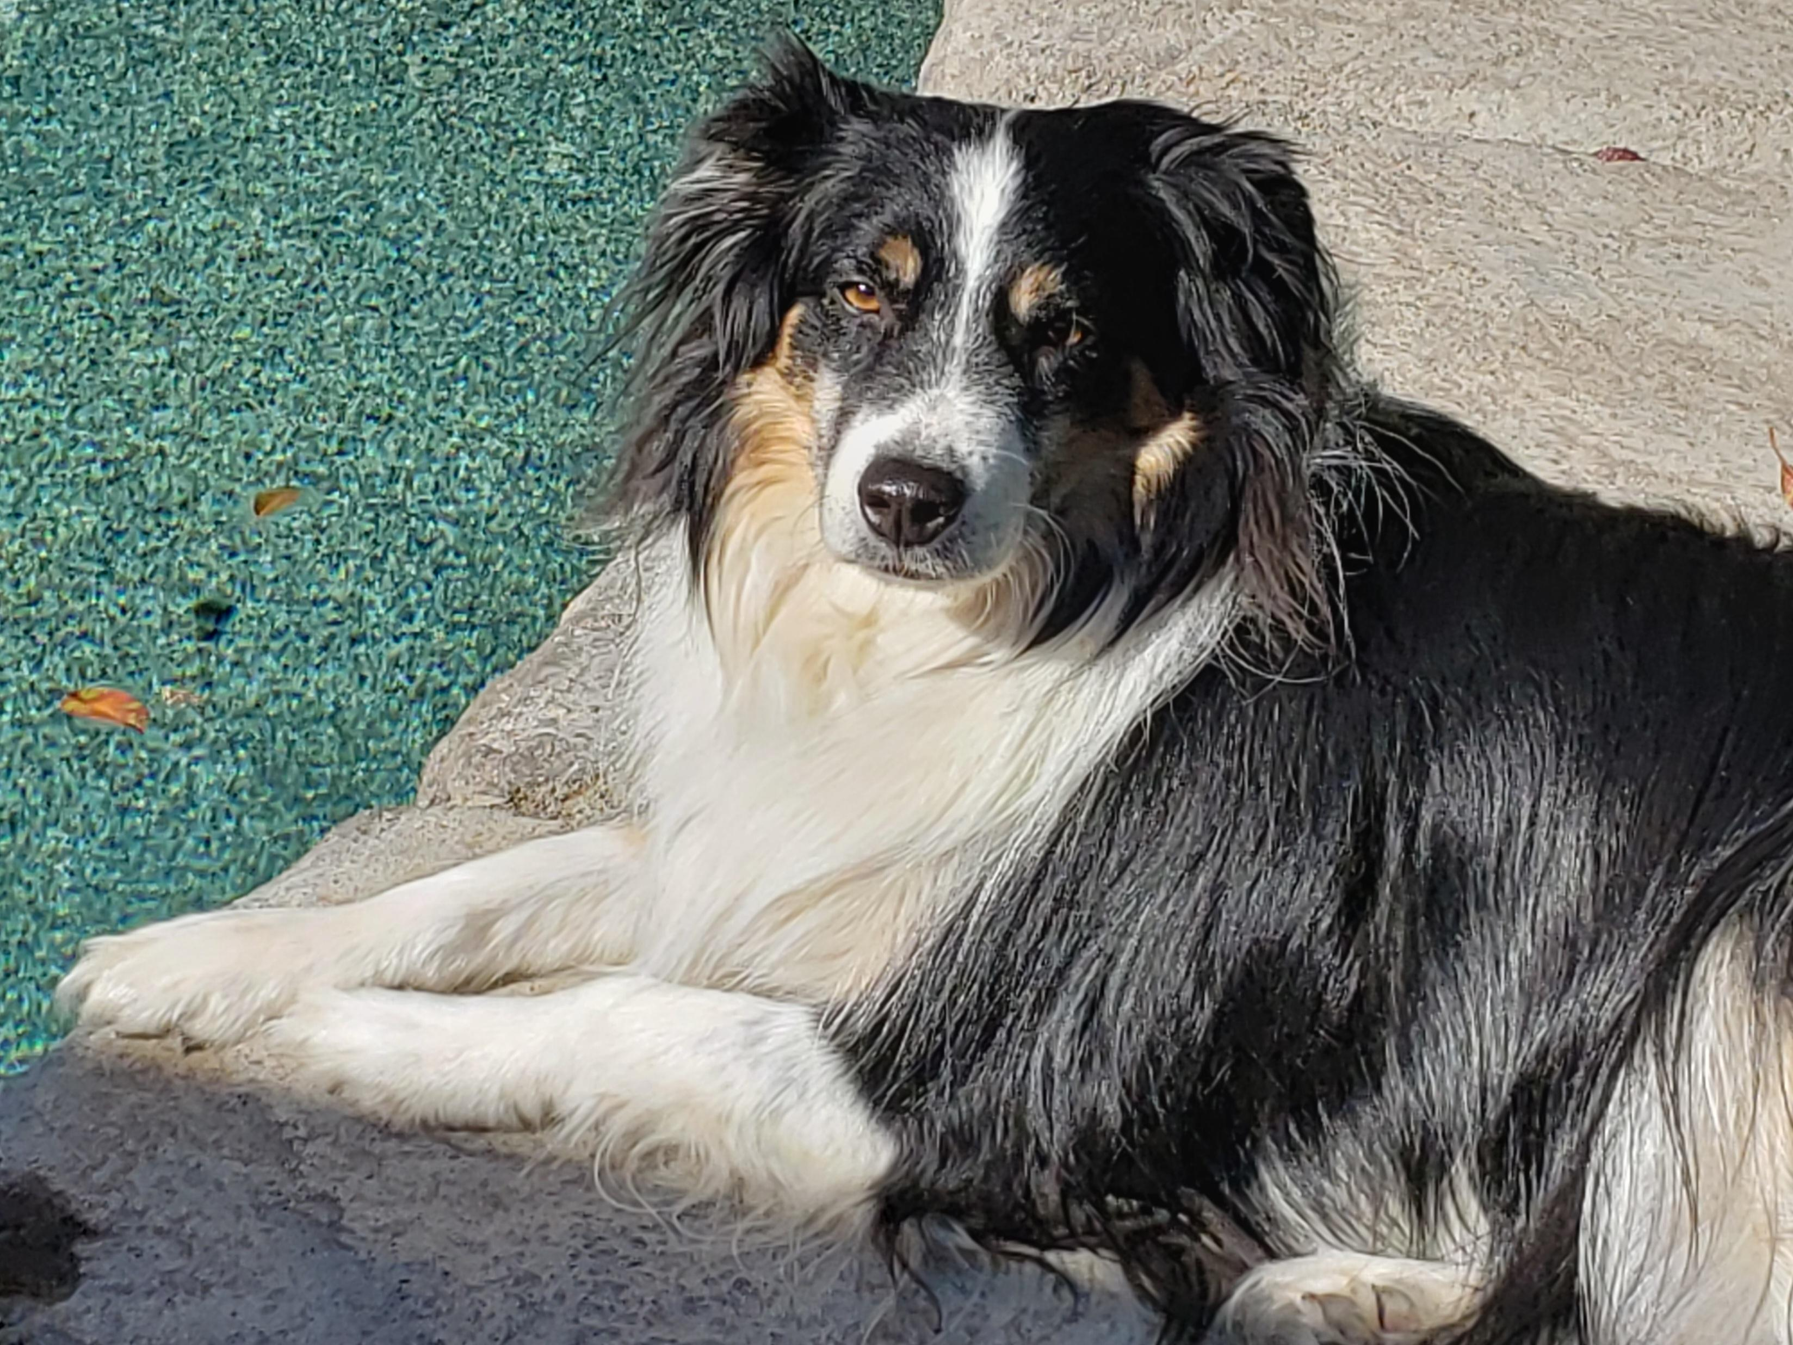
Why are we Reviewing our Budget Allocation Process?
It is important to continuously improve our processes
Some of the recommendations from last time were not implemented
Some assumptions about the base budget were not accurate
It is best practice to review every 5 years (it’s been 7)
The higher ed economic landscape has significantly changed
      Fewer high school graduates
      Less state support
      Value proposition of a degree

Slide 5
What is the difference between the budget model and the budgeting process?
The budget model is a mathematical prediction of our revenue and expenses which helps us forecast our resources and allocate resources at the institutional level.
The budgeting process is the approach we take to forecasting, planning, and allocating those resources in order to achieve our mission and strategic plan.

Slide 6
BARC committee members provide broad representation
School/College/Campus Unit | Name | Expertise/Contribution
CLAS | Rich Allen | Associate Dean
SPA | Lauren Goolsby | Director of Budget & Research Svcs
CAP | Stephanie Kelly | Assistant Dean
BUS | Scott Dawson | Dean representative
SEHD | Julia Mahfouz | BPC member for SEHD
CAM | Nate Thompson | Faculty; continuity for CAM
CEDC | Mark Golkowski | Department Chair, Electrical Engineering
Research | Phillip DeLeon | Innovation, data user; research emphasis
SESS | Margaret Wood | SESS leadership, faculty background
BPC | Julian Langou, Kelly McCusker | Faculty BPC standing committee liaisons
Staff Council | Anthony Wilson | Staff Council liaison
Chancellor’s representative | Beth Myers | Chancellor’s Cabinet liaison; data expert
Advancement | Nickolas Chabot-Olson | Donor and Campaign Relations liaison
Students | Michael Leaser | SGA liaison (possibly temporarily)
Facilitation provided by Ann Sherman & Jennifer St. Peter, with project support from Amy McGuire

Slide 7
Initial Topics Covered in 1st 2 BARC meetings
How was the budget model created?
Why are we doing this review now?
How does the budget model currently work?
Pain points: what are the presenting problems we might address
Myth busting regarding common assumptions
Development of criteria against we assess future options
Key messages each time

Slide 8
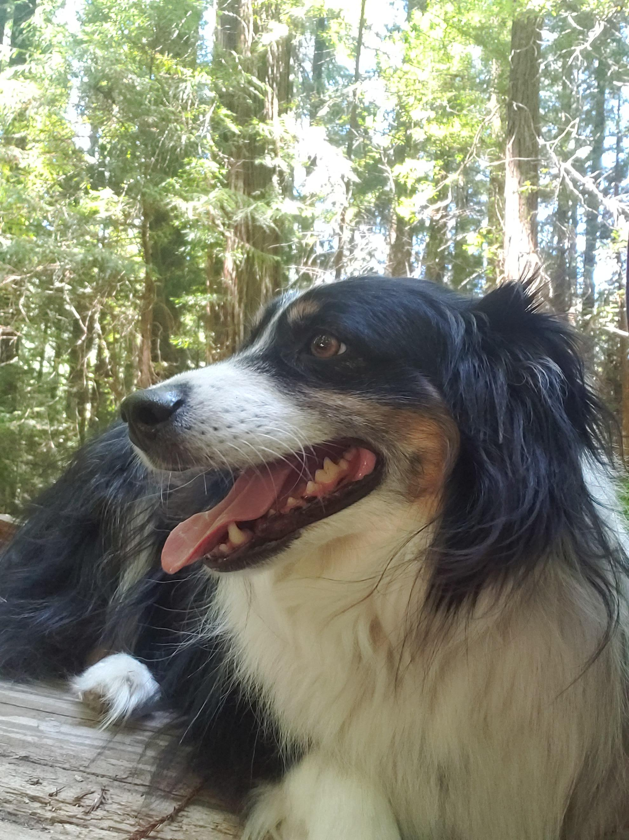
How does the Budget Model Currently Work (Simple)?
Projected Revenue
Estimated Expenditures
Mission Enhancement Fund
Subvention
Resources for Fiscal Year

Slide 9
How does the Budget Model Currently Work (Complex)?
Allocated via Metrics
100% Assigned to Academic Unit
Projected Revenue
Main Campus Tuition
State Appropriations
Differential Tuition
Gifts
Extended Studies
Auxiliary Activities
Indirect Cost Recovery (F&A)
Estimated Expenditures
Central Support Unit Allocations
Mission Enhancement Fund
Mission Enhancement Fund
(Main Campus Tuition + State appropriation + ICR + Auxiliary + Differential tuition) * Participation Fee
Subvention
Subvention (to schools/colleges)
Initiatives Pool
Resources for Fiscal Year
School/College Budget Allocation

Slide 10

PRESENTING PROBLEMS AND PAIN POINTS
What presenting problems or pain points did you hear from your faculty and staff colleagues?
What does “subvention” mean, and what is the impact on schools/colleges/units?
What are the rules and issues associated with D2 and D3?
How does the allocation process tie to our strategic plan?
Is one-time money, carry-forward funds, and cash all the same?
How can our model incentivize/encourage collaboration?
How might we mitigate budget volatility & plan more strategically long-term?
How can we encourage/support growth as our budgets get more constrained?
How does the model support ALL the university functions, even non-revenue-generating areas?
How do we best balance teaching, research, and student support goals?
Notes:
We have no continuing funds to support part-time instruction in the summer. We keep positions open to fund summer courses.

Slide 11

FACT OR MYTH?
There’s no incentive in our current budget model.
  Myth and Fact. The current model does incentivize student credit hours, which has been suspended. Is this the right thing to incentivize?
Administration can just give out additional budget in a year.
  Myth. The continuing budget is fully allocated at the beginning of the fiscal year.
Deans have discretion over allocations within their school/college.
  Fact. But they have limited discretionary funding due to salary and benefit obligations. This is the case in administration as well.
We HAVE to allocate budgets by student credit hours or majors.
  Myth. Budgets can be allocated in a variety of ways.
The timing of the budgeted allocation lags enrollment growth or decline.
  Fact. The current model allocates a fiscal year budget using metrics from two years ago.
The campus can guarantee future outcomes if a college/school makes a new program.
  Myth. While the campus can sometimes provide temporary support for a potential start-up program, there is no guarantee.
Notes:
All budgets have been declining since COVID.
Our tuition increase and increased state support have eased our budget crisis.
Other items found during discovery phase.

Slide 12
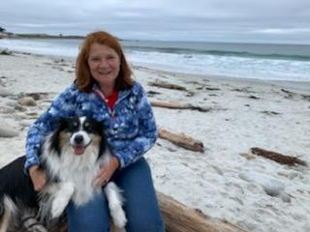
SUCCESS CRITERIA IDENTIFIED BY SUB-GROUPS
Increased flexibility, provides slack so that any time there is something unexpected we aren’t in a crisis
The budget recommendations support the strategic plan and strategic priorities – shared values, 2030 goals
The model accounts for yearly cost increases (tech, insurance, library, etc.)
Simple, predictable, transparent; simple enough to understand and articulate (not convoluted)
Long-term analysis for modeling and prediction/forecasting
Model includes a “human” element and is not just a formula
Baseline data for is correct, ensures that no unit starts “in the red” (in a deficit scenario)
Student retention and student experience
Encouragement of collaboration amongst schools and colleges
Opportunities for shared governance input

Slide 13
Key Messages from 1st 2 sessions
Session #1: September 5, 2024
We had a nice agenda, which generated very thoughtful questions
Transparency and sharing is fundamental to the way this group will work
The breadth and depth of representation on the committee is very meaningful
The group is committed to being available to our respective stakeholders, and to communicating broadly across the campus to foster shared meaning and understanding across the campus population.
We are committed to the goals laid out in the charge letter
Session #2: September 19 , 2024
It’s complicated!
There are no “easy” answers, but the committee members are committed to try and disentangle and make clear a budget model that supports all units to benefit the student experience on all levels of education.
Large conversation about student credit hours and headcount – conversation about methods for allocating revenue.
The committee examined myths and facts about how our model and process works to clarify some common points of confusion.

Slide 14
Work Plan for the Academic Year Ahead
Meeting dates:
    September 5 & 19
    October 10 & 24
    November 7 & 21
    December 12
    January 30
    February 13 & 27
    March 13
    April 9, 17, 24
Communication windows:
  September 23-October 4
  October 28-November 8
  November 21-December 12
  March 13-April 3
  Week of April 28
These dates were chosen to best map against semester demands and holiday/spring breaks, while still providing a regular cadence for committee progress and campus updates.

Slide 15
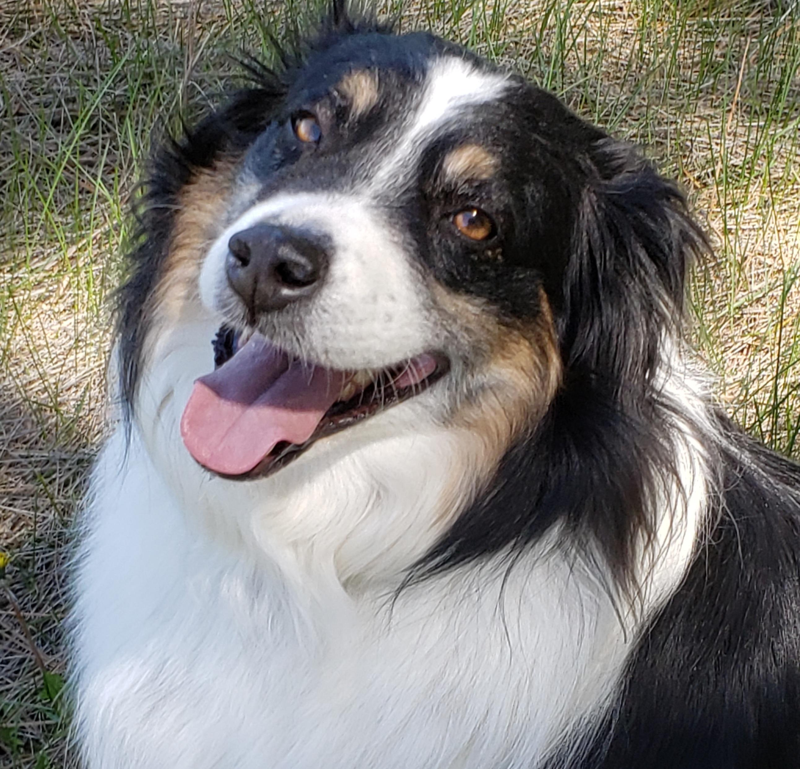
For more Information……
https://www.ucdenver.edu/offices/budget/budget-process/2024-budget-model-revision-process

Slide 16
Other questions?
Ann Sherman
ann.sherman@ucdenver.edu
Jennifer St. Peter
jennifer.stpeter@ucdenver.edu

