Slide 1
BUDGET ALLOCATION REVIEW COMMITTEE
Session #4
October 24, 2024

Slide 2
AGENDA
1.
Recap from Session #3
2.
Decision points
3.
Key Messages from Session #4

Slide 3
RECAP FROM
SESSION #3

Slide 4
RESULT FROM SESSION #3 HOMEWORK
1
Develop a flexible budget model that aligns financial resources with campus vision, mission, and strategic priorities as a student-centered, urban-serving research university

Slide 5
RESULT FROM SESSION #3 HOMEWORK
Ensure and support continuous improvement in academic quality, scholarship, and student success
2

Slide 6
RESULT FROM SESSION #3 HOMEWORK
3
While promoting fiscal responsibility and financial sustainability, provide a simple, predictable, and transparent methodology for allocating resources and managing associated costs

Slide 7
RESULT FROM SESSION #3 HOMEWORK
4
Building on the strengths of CU Denver, include incentives for achieving growth, efficiency, effectiveness, innovation, and entrepreneurship

Slide 8
RESULT FROM SESSION #3 HOMEWORK
5
Reflect a shared commitment for the fiscal health of the campus and promote collaboration and accountability across all academic and administrative units

Slide 9
RESULT FROM SESSION #3 HOMEWORK
2
Ensure and support continuous improvement in academic quality, scholarship, and student success
1
Develop a flexible budget model that aligns financial resources with campus vision, mission, and strategic priorities as a student-centered, urban-serving research university
3
While promoting fiscal responsibility and financial sustainability, provide a simple, predictable, and transparent methodology for allocating resources and managing associated costs
4
Building on the strengths of CU Denver, include incentives for achieving growth, efficiency, effectiveness, innovation, and entrepreneurship
5
Reflect a shared commitment for the fiscal health of the campus and promote collaboration and accountability across all academic and administrative units

Slide 10
RESULT FROM SESSION #3 HOMEWORK

Slide 11
DECISION POINTS IN AN INCENTIVE-BASED MODEL

Slide 12
DECISION POINTS
Topic | Discussion Points
Revenue Allocations | What incentives should be created through revenue allocations? Based on desired incentives, how should each type of unrestricted fund revenues be treated? Pooled or direct allocation? How should auxiliary revenues be treated? Pooled or direct allocation?
Indirect Costs | How should campus-wide expenses be funded? Front-end, allocated, or back-end? How should administrative and support units be funded? Front-end, allocated, or back-end? If indirect costs are to be allocated, what variables should be used for each pool?
University Revenues (Mission Enhancement Fund) | How should funds for units not able to cover their direct expenses be created? Front-end or back-end? How should funds for strategic initiatives be created? Front-end or back-end? Should select revenue(s) be retained or should a formula help create this? If select revenues are retained, which ones should be considered? If a formula/participation rate is selected, what funds should be subject or exempt from the rate?

Slide 13
REVENUE ALLOCATIONS
What incentives should be created through revenue allocations?
  Instruction, majors, research, outcomes/outputs?
Based on desired incentives, how should each type of unrestricted fund revenues be treated?
  Tuition
  Differential tuition
  State support
  Indirect Cost Recovery
How should auxiliary revenues be treated?
  Extended Studies
  Sales & Services of Educational Activities
Current budget model:
    Pools tuition revenue and allocates based on instruction and majors
    Pools state support and allocates incrementally
    Pools indirect cost recovery and allocates based on sponsored research expenditures
    Directly allocates auxiliary revenues to the academic units, but this revenue has no impact on the unrestricted fund budget

Slide 14
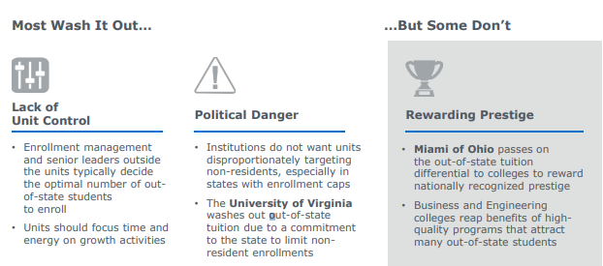
TYPES OF TUITION DIFFERENTIALS
There are two types of differential tuitions built into the CU Denver tuition structure:
    Specific higher tuition rates for high cost of instruction units
    Out-of-state tuition
Current budget model:
    Directly allocates specific higher tuition rates for high cost of instruction units
    Separates out-of-state tuition from in-state tuition and allocates separately

Slide 15
INDIRECT COSTS
How should campus-wide expenses be funded? What level of influence do academic units have over their share of these expenses?
  Through a set percentage?
  Allocated in the model?
How should administrative and support units be funded?
  Through a set percentage?
  Allocated as expenses in the model?
  Hybrid, with some costs off the top and others allocated?
If indirect costs are to be allocated, what variables should be used for each pool?
Current budget model:
    Allocates campus-wide expenses in the model
    Allocates administrative and support unit expenses in the model
    Has seven cost pools, each with its own variables to allocate the expenses

Slide 16
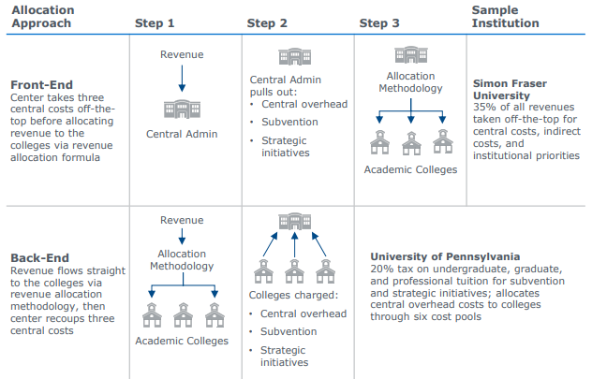
INDIRECT COSTS
Taking central costs off at the front-end:
    Is simple
    Shares increases or decreases in revenue between academic and administrative units
    Can be seen as less transparent, prevents the calculation of a “unit margin”
Allocating central costs “at the back-end” within the model:
    Adds complexity to the model
    Implies that academic units have control over their portion of central costs and can reduce consumption or otherwise change behavior to influence total spending
    Can be seen as more transparent

Slide 17
UNIVERSITY REVENUES (MISSION ENHANCEMENT FUND)
How should funds for units not able to cover their direct expenses be created?
How should funds for strategic initiatives be created?
Should select revenue(s) be retained or should a formula help create this?
If select revenues are retained, which ones should be considered?
If a formula/participation rate is selected, what funds should be subject or exempt from the rate?
Current budget model:
    Includes the Mission Enhancement Fund, which supports units that are not able to cover direct expenses as well as strategic initiatives
    Uses a formula to create the Mission Enhancement Fund

Slide 18
UNIVERSITY REVENUES (MISSION ENHANCEMENT FUND)
Similar to indirect costs, the Mission Enhancement Fund can be built through assessment at the front-end or the back-end.
The fund can be built by retaining specific revenue sources for this purpose, assessing a fee on campus revenue prior to allocating through the budget model, or through a “participation fee” within the budget model.
 | Revenue Retention | Front-End Assessment | Participation Fee
Description | Select revenues are retained | Front-end revenue assessment | Participation fee assessed to academic units
Pros | Provides direct funding mechanism Simple | Simple | Diversified revenue sources to build the Pool from As academic units grow, so does the Pool
Cons | Future Growth opportunity of Pool often limited Pool size can be volatile due to lack of revenue diversification | Can be seen as less transparent, prevents the calculation of a “unit margin” Rate needs to be adjusted based on revenue trends; if revenue decreases, rate may need to increase | Rate needs to be adjusted based on revenue trends; if revenue decreases, rate may need to increase

Slide 19
KEY MESSAGES FROM SESSION #4

Slide 20
WHAT ARE THE KEY MESSAGES FROM THIS SESSION?
Budget model needs to consider the difference in costs between different academic programs.
Committee identified the areas for decision-making: revenue allocation, indirect costs, and university revenues/Mission Enhancement Fund
Narrow down the types of budget model the committee wants to continue investigating

